Slide 1
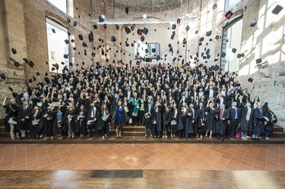
WELCOME DAY
September 26th15-17
Aula Poeti, Palazzo Hercolani, Strada Maggiore, 45
International Relations Master Degree Programme
Opening remarks by IR Coordinator, prof. Giovanni Giorgini
Unibo- Johns Hopkins University Agreement – prof. Raffaella Baritono
Study plans: how and when to submit –IR tutor, Marianna Ragone
Curricular traineeships: opportunities and modality – Simona Mattioli and Ivana Borghi (Traineeship Office)
Academic Mobility – Laura Carra

Slide 2
Event Programme
Opening remarks by RILM coordinator, prof. Giovanni Giorgini
Unibo- John Hopkins University Agreement – prof. Raffaella Baritono
Study plans: how and when to submit –RILM tutor, Marianna Ragone
Curricular traineeships: opportunities and modality – Simona Mattioli e Ivana Borghi (Traineeship Office)
Academic Mobility – Laura Carra (International Mobility Office)

